Slide 1

UML Modeling
Coming up: Introduction
Notes:
Additional information:
http://www.rational.com/uml/resources.html

Slide 2

Use Case: “... a typical interaction between a user and a computer system”, Booch
  Here, “user” is anything that needs or invokes the functionality of the system
  “Computer system” is the system being modeled
Use cases can capture and document the user-visible functionality of a system
Use cases capture how the system will benefit the user
Each use case achieves a discrete goal for the user
Coming up: Example Use Case Diagram
Notes:
Examples of modeling languages:
Data Flow Diagrams
Entity Relationship Diagrams
Flow Charts
Context Diagrams
State Charts
Object-oriented Systems Modeling (OSM)
The term model is actual a more appropriate term for what Booch, et al.m informal refer to as a modeling language.

Slide 3
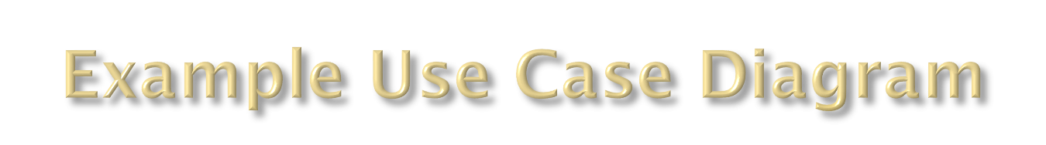
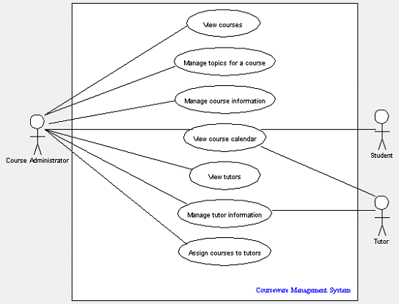
Coming up: Goals

Slide 4

Use cases help everyone come to a common understanding of what the system should do
  Developers
  End-users
  Domain Experts
Use-cases are a communication tool for the design (not the implementation)
Use cases represent functional requirements of system (as a whole)
Coming up: Use Case Diagrams
Notes:
Examples of modeling languages:
Data Flow Diagrams
Entity Relationship Diagrams
Flow Charts
Context Diagrams
State Charts
Object-oriented Systems Modeling (OSM)
The term model is actual a more appropriate term for what Booch, et al.m informal refer to as a modeling language.

Slide 5



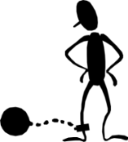
Use Case Diagrams provide a visual way to document user goals and explore possible functionality
Three primary modeling components:
  Actors
  Use Cases
  Relationships between use cases
Record class grades
Review Transcripts
Teacher
Authorized
Staff Worker
Student
Coming up: Actors

Slide 6

Actors are things outside the system that need to interact with the system
Actors carry out use cases
Actors are represented as stick figures
Although users are actors, not all actors are users
  Actors can be external software systems
  External hardware (sensors, actuators, etc.)
  Actors can be people that need the functionality of the system, but may not be the ones who actually invoke the software commands
Coming up: Hints for Finding Actors

Slide 7
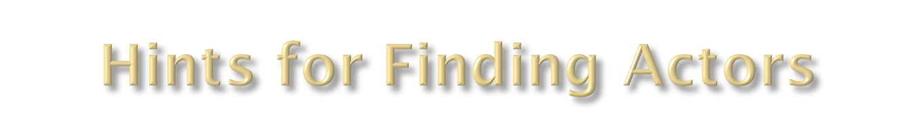
Who or what will use the main functionality of the system?
Who or what will provide input to this system?
Who or what will use output from this system?
Who will need support from the system to do their work?
Are there any other software systems with which this one needs to interact
Are there any hardware devices used or controlled by this system?
Coming up: Hints for Modeling Actors

Slide 8
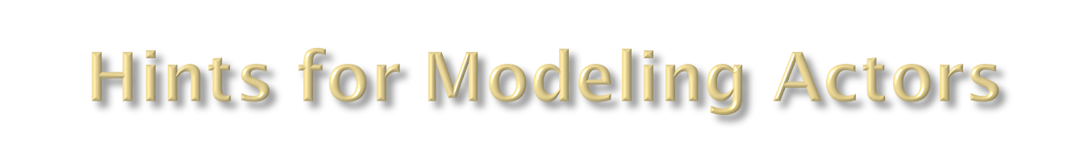
An actor can be a role that a user plays with respect to the system
A single person may play different roles
A single actor may perform many use cases
A use case may be performed by many actors
Show external systems as actors only when they are the ones who need a use case
Coming up: Relationships Between Actors

Slide 9

Appropriate use case names are very important. Because they are selected early, they tend to set the direction for the entire project.
  Must be a complete process from the viewpoint of the end user.
  Usually in verb-object form, like Buy Pizza
  Use enough detail to make it specific
  Use active voice, not passive
  From viewpoint of the actor, not the system
  Golden Rule: Each use case should have a name that indicates what value (or goal) is achieved by the actor's interaction with the system.

Slide 10
Naming Use-Cases
Quick Test: Use Case Name Examples
Purchase Concert Ticket
Purchase Concert Tickets
Purchase Ticket
Ticket Purchase
Ticket Order
Pay for Ticket

Slide 11
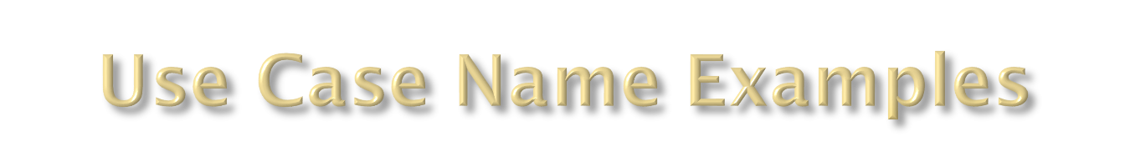
Naming Use-Cases
Excellent - Purchase Concert Ticket
Very Good - Purchase Concert Tickets
Good - Purchase Ticket (insufficient detail)
Fair - Ticket Purchase (passive)
Poor - Ticket Order (system view, not user)
Unacceptable - Pay for Ticket (procedure, not process)

Slide 12

Actors cam be related by generalization/specialization
Actors are classifiers (not individual users)
Student
Do this when very obvious
Graduate Student
Coming up: Use Cases

Slide 13

Each use case represents something the user needs to do with the system – a goal
A use cases is given a short name and textual description
Use cases can be large or small from a conceptual perspective
Coming up: Use Case Relationships
Notes:
Validate User (General) --- Specialization: retinal scan, key-card scan
Extends - Hire Employee --- Hire international employee
Includes - process data --- login to system

Slide 14
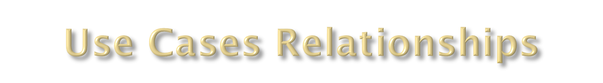
Use cases can relate to each other via dependencies, such as
  <<extends>>
  <<includes>>
  Generalization or <<refines>> (“is a”)

Slide 15
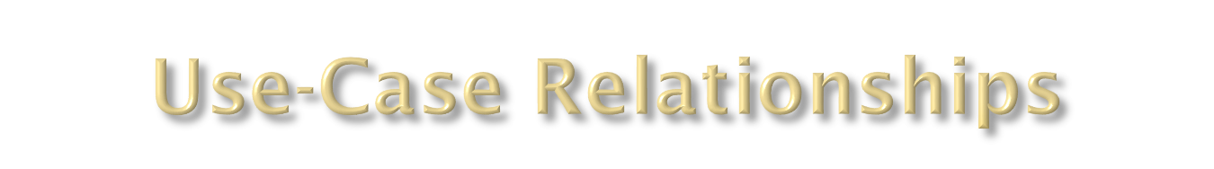
Includes Dependency:
  The «include» relationship allows us to include the steps from one Use Case into another.
  This is valuable when the included steps occur as a recognizable sequence in many different contexts.
Coming up: Use-Case Relationships

Slide 16

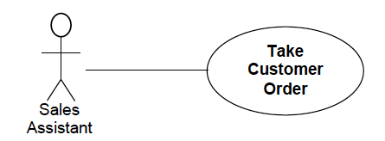

Slide 17
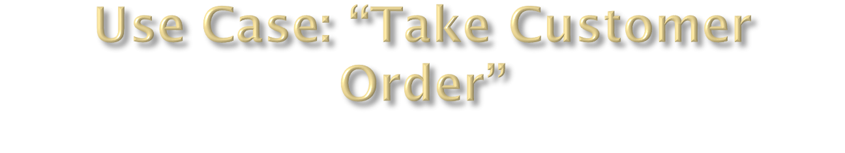
Basic Flow:
1. Actor enters Customer details
2. Actor enters code for product required
3. System displays Product details
4. Actor enters quantity required
5. Actor enters Payment details
6. System saves Customer Order

Slide 18
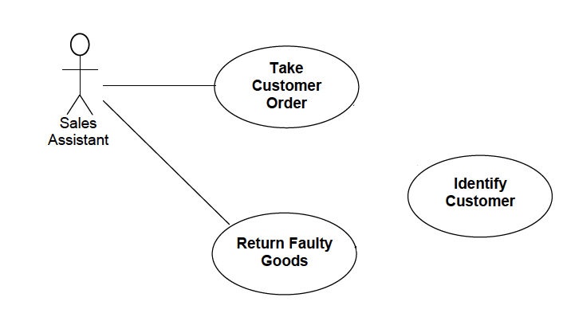

Slide 19
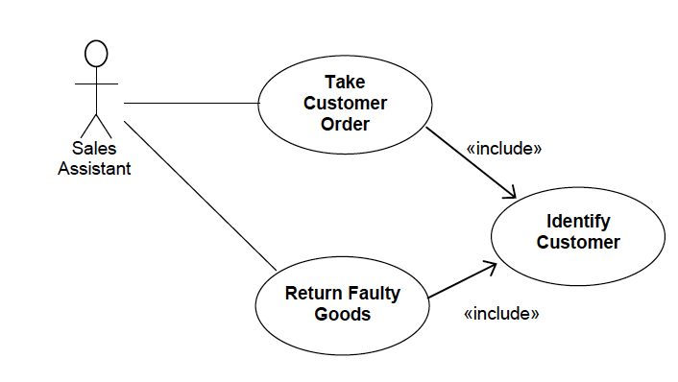

Slide 20

The «extends» relationship allows us to modify the behavior of the base Use Case.
defines a use-case that is a variation of another, usually for handling an abnormal situation

Slide 21
Suppose we want to sell products that are made to order and require a degree of customer specification. For these products we will need to record the customer’s additional requirements, such as size and color.

Slide 22
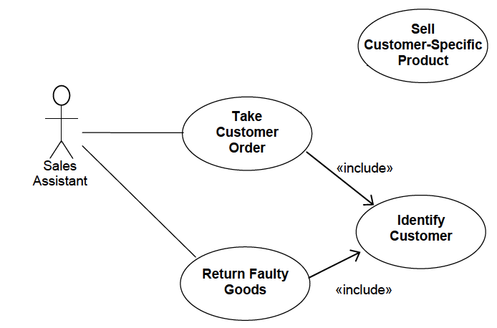

Slide 23
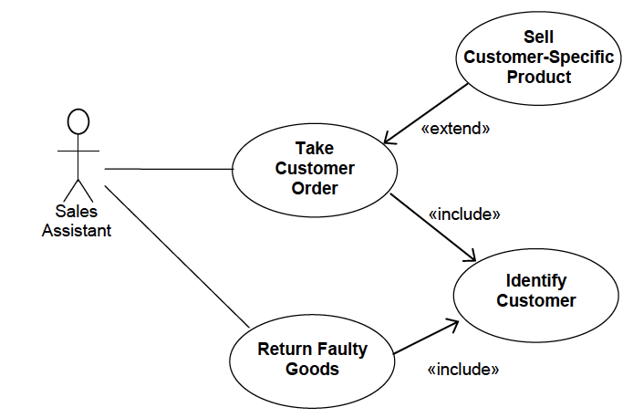

Slide 24
Extends dependency:
Alter Student Grade
<<extends>>
Alter student grade for a class taken more than a year ago
Authorized
Staff Worker
Coming up: Use-Case Relations

Slide 25

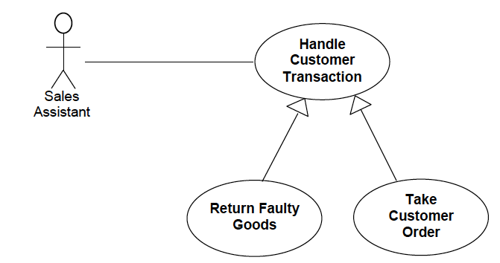

Slide 26
What could be the generalization of “Alter student grade”?

Slide 27

Generalization: Defines one use case as a generalization of another.
Alter Student Grade
Alter Student Grade for a Graduate Course
Teacher
Coming up: Hints for Finding Use Cases

Slide 28
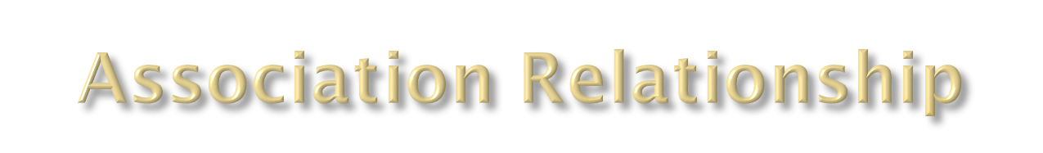
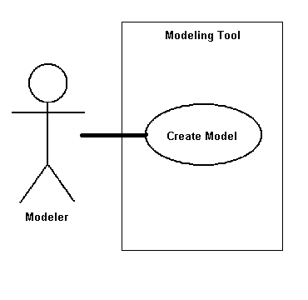
An association is the communication path between an actor and the use case that it participates in
  It is shown as a solid line
  It does not have an arrow, and is normally read from left to right
  Here, the association is between a Modeler and the Create Model use case

Slide 29
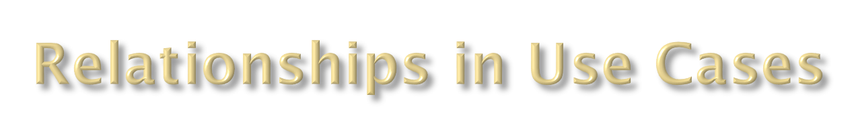
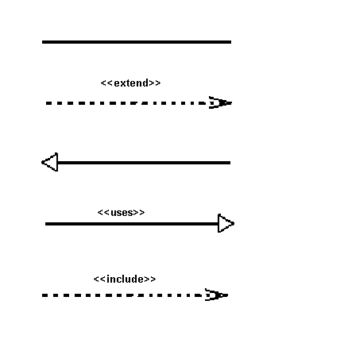
There are several Use Case relationships:
  Association
  Extend
  Generalization
  Uses
  Include
Most Use Cases have only associations. Use other relationships sparingly.

Slide 30

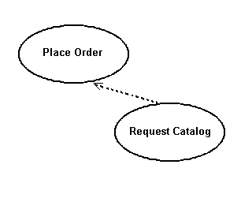
Extend puts additional behavior in a use case that does not know about it.
It is shown as a dotted line with an arrow point and labeled <<extend>>
In this case, a customer can request a catalog when placing an order.

Slide 31

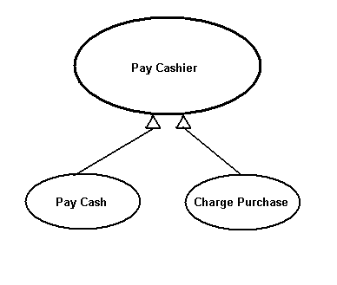
When a use case uses another process, the relationship can be shown with the uses relationship
This is shown as a solid line with a closed arrow point and the <<uses>> keyword
Here different system processes can use the logon use case

Slide 32

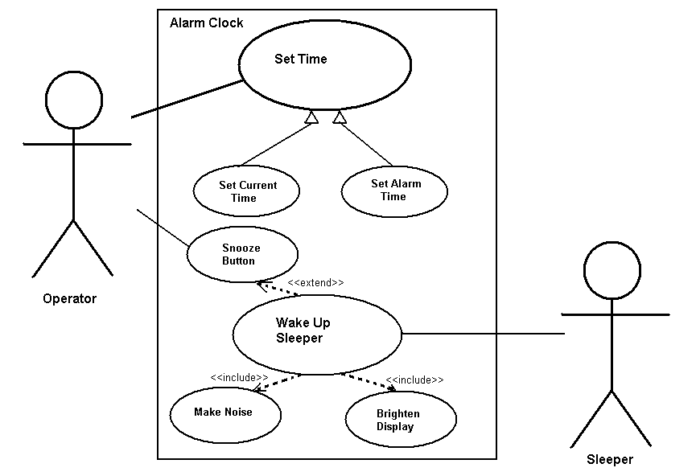
This is a contrived
example, to show
many relations.
Your diagrams
should be simpler.

Slide 33

An executive at a chain of family restaurants called Brampton's Pizza and Pasta. They are looking to develop some software for in-house use at their restaurants. Their goal is to take the restaurant ordering process and make it more efficient. She is thinking that customers should be able to view the menu of the restaurant they're in, and once they're ready, place an order. She'd really like there to be a kids' page where you can see the kids' menu. Maybe there's a few games for the kids to play, but most importantly, it should be easy enough to use that kids can make an order themselves. Customers should also be able to specify any changes they'd like to make for their meal, and they should be able to list any dietary restrictions they may have before they submit their order to the kitchen. The kitchen should then be able to view these orders as they come in. Customers should be able to view and pay their bill within the system.

